Slide 1


Welcome to Car Buddy
The App that will never leave you stranded
Kurt Vandergriff / Christopher Flanigan

Slide 2
Mission Statement
CAR BUDDY
OUR MISSION IS TO EFFICIENTLY CREATE USER FRIENDLY SERVICES AS
WELL AS TO MEET OUR CUSTOMER'S NEEDS.
February 26, 2018
GOALS
User friendly app creation
Through our design and programming team we will use information gathered from our PR department, using surveys, to create an app that is easy on the eyes and easy on the brain when it comes to smooth usage.
Everyone has their own mechanic no matter where they are
To give a sense of safety and hope in the event of a break down or simply working in your own driveway.
Understandable to everyone
Making the explanations and tutorials easy to follow and understand without having to be a certified mechanic
Affordability
Creation of an app that anyone can afford to have on their phones or laptops
To be the epicenter of go-to knowledge
Our app will be what every goes to for quick but extensive knowledge about automobile troubles and how to fix

Slide 3
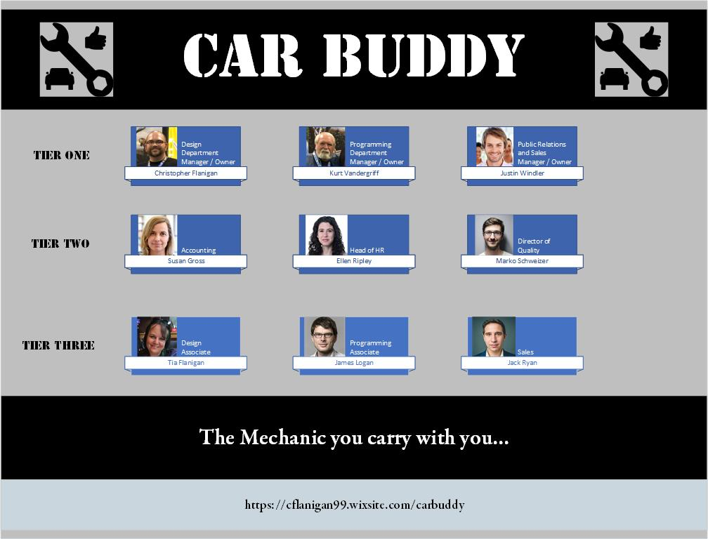
Organizational Chart of the Car buddy Team Tier one: owners tier two: managers tier three: associates

Slide 4
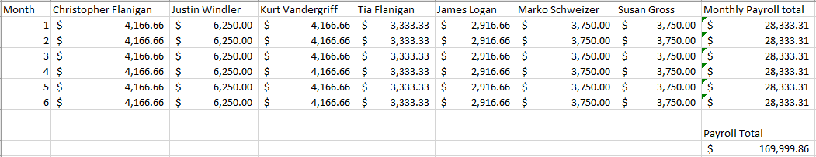

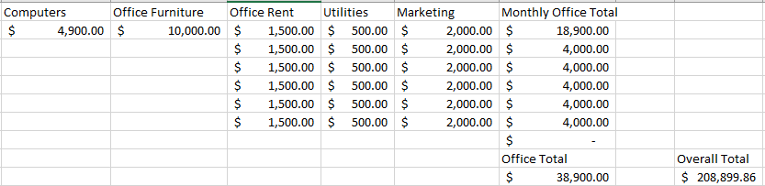
Six Month Budget for Car Buddy

Slide 5
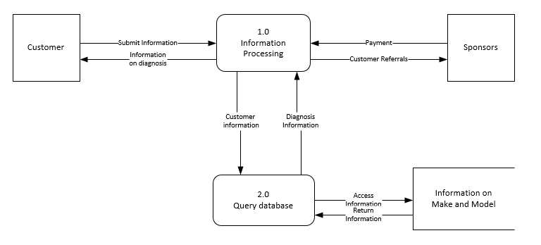

Car Buddy Data Flow Diagram

Slide 6

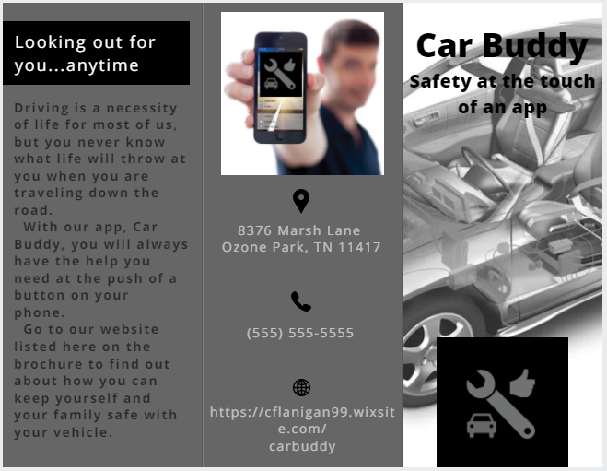

Marketing
More to come…

Slide 7
Car Buddy online
https://cflanigan99.wixsite.com/carbuddy

